Slide 1
Exception Handling

Slide 2
Exception-Handling Fundamentals
An exception is an abnormal condition that arises in a code sequence at run time
A Java exception is an object that describes an exceptional condition that has occurred in a piece of code
When an exceptional condition arises, an object representing that exception is created and thrown in the method that caused the error
An exception can be caught to handle it or pass it on
Exceptions can be generated by the Java run-time system, or they can be manually generated by your code

Slide 3
Exception-Handling Fundamentals
Java exception handling is managed by via five keywords: try, catch, throw, throws, and finally
Program statements to monitor are contained within a try block
If an exception occurs within the try block, it is thrown
Code within catch block catch the exception and handle it
System generated exceptions are automatically thrown by the Java run-time system
To manually throw an exception, use the keyword throw
Any exception that is thrown out of a method must be specified as such by a throws clause

Slide 4
Exception-Handling Fundamentals
Any code that absolutely must be executed before a method returns is put in a finally block
General form of an exception-handling block
try{
// block of code to monitor for errors
}
catch (DataAccessException exOb){
// exception handler for DataAccessException
}
catch (PICFServiceException exOb){
// exception handler for PICFServiceException
}
//…
finally{
// block of code to be executed before try block ends
}

Slide 5
Types of exceptions
Checked exceptions – inability to acquire system resources (such as insufficient memory, file does not exist)
Java checks at compile time that some mechanism is explicitly in place to receive and process an exception object that may be created during runtime due to one of these exceptions occurring.
Unchecked exceptions – exceptions that occur because of the user entering bad data, or failing to enter data at all.
Unchecked exceptions can be avoided by writing more robust code that protects against bad input values. Java does not check at compile time to ensure that there is a mechanism in place to handle such errors.
It is often preferred to use Java’s exception handling capabilities to handle bad user input rather than trying to avoid such circumstances by providing user-input validation in the code.

Slide 6
Exception Handler
Exception "thrown" here
Thrown exception matched against first set of exception handlers
Exception handler
If it fails to match, it is matched against next set of handlers, etc.
Exception handler
If exception matches none of handlers, program is abandoned

Slide 7
Exception Types
All exception types are subclasses of the built-in class Throwable
Throwable has two subclasses, they are
  Exception (to handle exceptional conditions that user programs should catch)
    An important subclass of Exception is RuntimeException, that includes division by zero and invalid array indexing
  Error (to handle exceptional conditions that are not expected to be caught under normal circumstances). i.e. stack overflow

Slide 8
Uncaught Exceptions
If an exception is not caught by user program, then execution of the program stops and it is caught by the default handler provided by the Java run-time system
Default handler prints a stack trace from the point at which the exception occurred, and terminates the program
Ex:
class Exc0 {
public static void main(String args[]) {
int d = 0;
int a = 42 / d;
}
}
Output:
java.lang.ArithmeticException: / by zero
at Exc0.main(Exc0.java:4)
Exception in thread "main"

Slide 9
Using try and catch
Handling an exception has two benefits,
  It allows you to fix the error
  It prevents the program from automatically terminating
The catch clause should follow immediately the try block
Once an exception is thrown, program control transfer out of the try block into the catch block
Once the catch statement has executed, program control continues with the next line in the program following the entire try/catch mechanism

Slide 10
Sequence of Events for throw
try block
throw
statement
unmatched catch
matching catch
unmatched catch
next step

Slide 11
Sequence of Events for No throw
try block
throw
statement
unmatched catch
matching catch
unmatched catch
next step
Preceding step

Slide 12
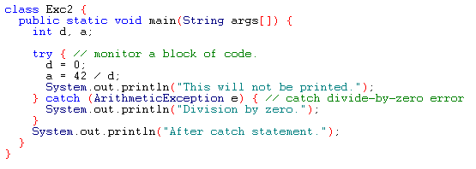
Example
Output:
Division by zero.
After catch statement.

Slide 13
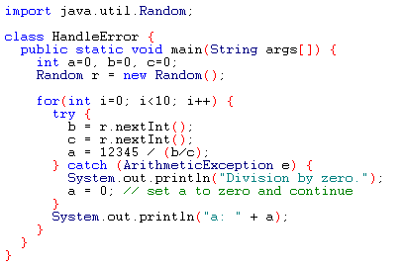
Using try and catch
A try and catch statement form a unit. The scope of the catch clause is restricted to those statements specified by the immediately preceding try statement
You cannot use try on a single statement

Slide 14
Multiple catch Clauses
If more than one can occur, then we use multiple catch clauses
When an exception is thrown, each catch statement is inspected in order, and the first one whose type matches that of the exception is executed
After one catch statement executes, the others are bypassed

Slide 15
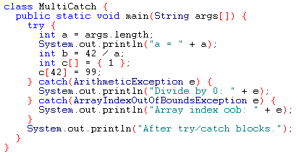
Example

Slide 16
Example (Cont.)
If no command line argument is provided, then you will see the following output:
a = 0
Divide by 0: java.lang.ArithmeticException: / by zero
After try/catch blocks
If any command line argument is provided, then you will see the following output:
a = 1
Array index oob: java.lang.ArrayIndexOutOfBoundsException
After try/catch blocks.

Slide 17
Caution
Remember that, exception subclass must come before any of of their superclasses
Because, a catch statement that uses a superclass will catch exceptions of that type plus any of its subclasses. So, the subclass would never be reached if it come after its superclass
For example, ArithmeticException is a subclass of Exception
Moreover, unreachable code in Java generates error

Slide 18
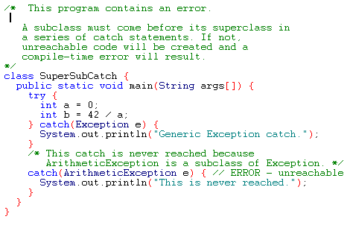
Example

Slide 19
Nested try Statements
A try statement can be inside the block of another try
Each time a try statement is entered, the context of that exception is pushed on the stack
If an inner try statement does not have a catch, then the next try statement’s catch handlers are inspected for a match
If a method call within a try block has try block within it, then then it is still nested try

Slide 20
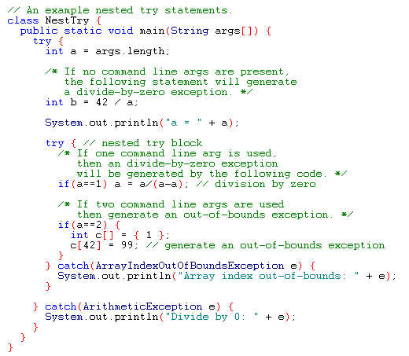
Example

Slide 21
Output
When no parameter is given:
Divide by 0: java.lang.ArithmeticException: / by zero
When one parameter is given
a = 1
Divide by 0: java.lang.ArithmeticException: / by zero
When two parameters are given
a = 2
Array index out-of-bounds: java.lang.ArrayIndexOutOfBoundsException

Slide 22
throw
It is possible for your program to to throw an exception explicitly
throw TrrowableInstance
Here, TrrowableInstance must be an object of type Throwable or a subclass Throwable
There are two ways to obtain a Throwable objects:
  Using a parameter into a catch clause
  Creating one with the new operator

Slide 23
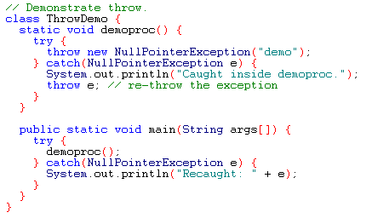
Example
Output:
Caught inside demoproc.
Recaught: java.lang.NullPointerException: demo

Slide 24
throws
If a method is capable of causing an exception that it does not handle, it must specify this behavior so that callers of the method can guard themselves against that exception
type method-name parameter-list) throws exception-list
{
// body of method
}
It is not applicable for Error or RuntimeException, or any of their subclasses

Slide 25
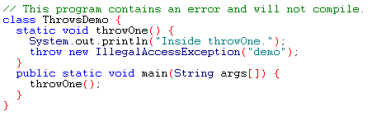
Example: incorrect program

Slide 26
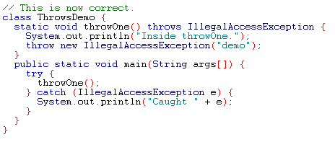
Example: corrected version
Output:
Inside throwOne.
Caught java.lang.IllegalAccessException: demo

Slide 27
finally
It is used to handle premature execution of a method (i.e. a method open a file upon entry and closes it upon exit)
finally creates a block of code that will be executed after try/catch block has completed and before the code following the try/catch block
finally clause will execute whether or not an exception is thrown

Slide 28
Sequence of Events for finally clause
try block
throw
statement
unmatched catch
matching catch
unmatched catch
finally
next step
Preceding step

Slide 29
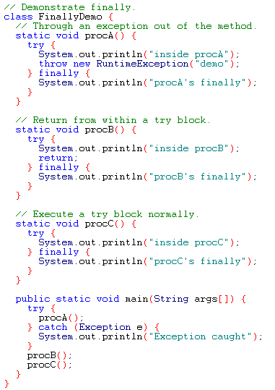
Example

Slide 30
Output
inside procA
procA's finally
Exception caught
inside procB
procB's finally
inside procC
procC's finally

Slide 31
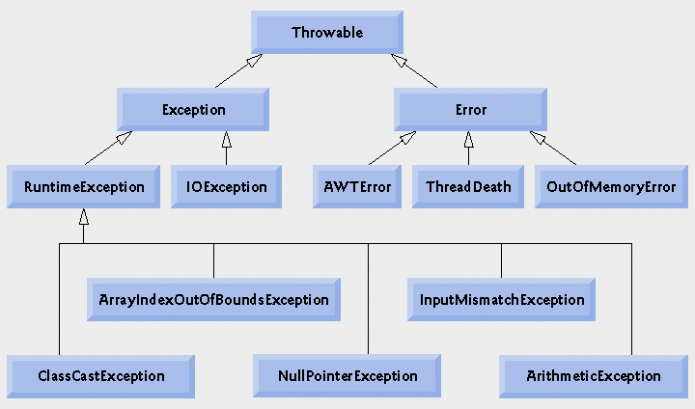
Inheritance hierarchy for class Throwable

Slide 32
User Defined Exceptions
public class GarageFull extends Exception {
private int capacity;
public GarageFull(int s){
capacity = s;
}//end GarageFull
public int getCapacity(){
return capacity;
}//end getCapacity
} //end class GarageFull
public class Garage {
private Vehicle[] fleet = new Vehicle[100];
private int count = 0;
public void addVehicle(Vehicle v) throws GarageFull {
if (count =fleet.length)
throw new GarageFull(count);
else
fleet[count++] = v;
}//end add Vehicle
public void init(){
try {
myGarage.addVehicle(new Car(“ABC123”,4));
} //end try
catch(GarageFull gf){
System.err.println(“Operation failed”);
System.err.println(“Capacity is “ + gf.getCapacity());
} //end catch
}

Slide 33
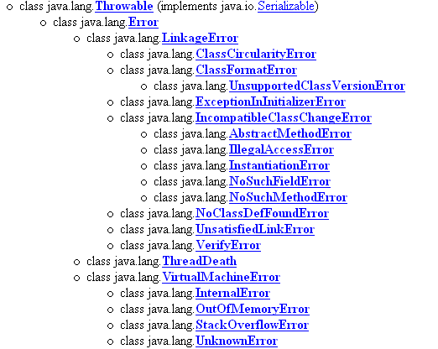
Java’s Built-in Errors
Small letter indicate package name
Capital letter indicate class name

Slide 34
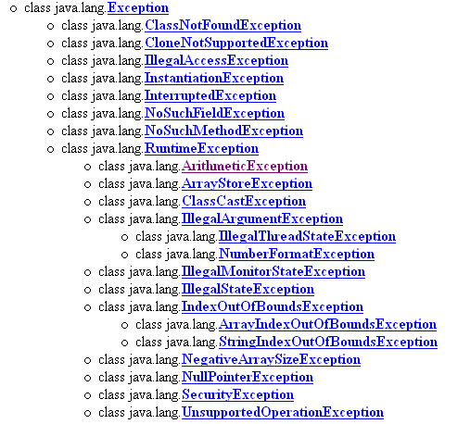
Java’s Built-in Exceptions

Slide 35
Thank You

